Slide 1
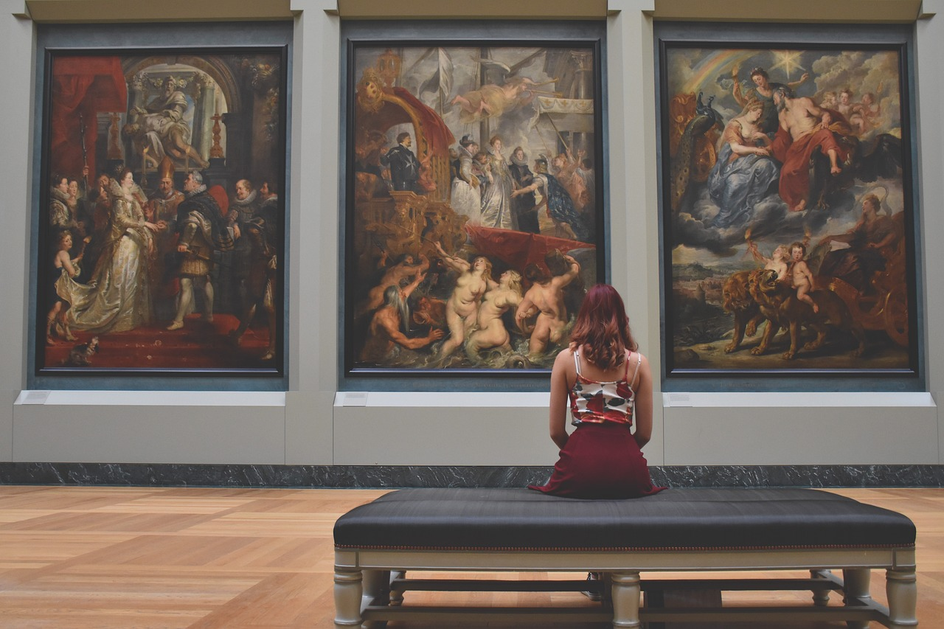
E-Museum
DIKSHA VARSHNEY

Slide 2
UPCOMING CONTENTS
Introduction.
Review.
Objective.
Modules.
Sub Modules.
Technologies.
Software.
Conclusion.

Slide 3
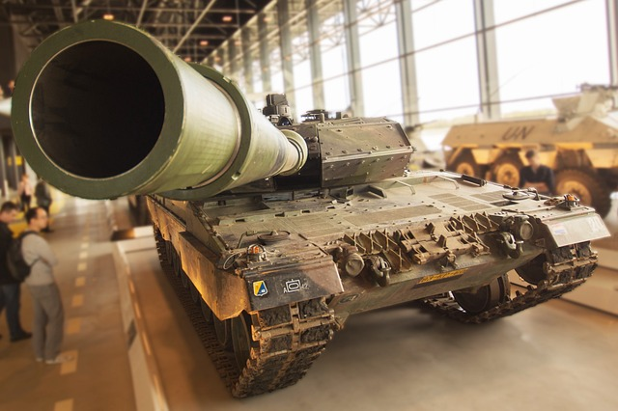
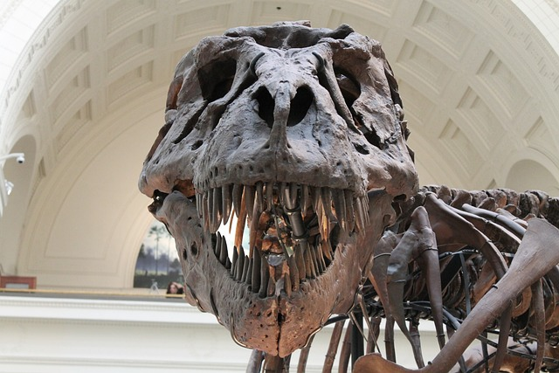
INTRODUCTION
The E-Museum is more than just a website; it's an immersive journey into the heart of art, history, and science. Whether you're an avid art enthusiast, a history buff, a science aficionado, or simply a curious explorer, our platform has something for everyone. With a vast collection of images, videos, and detailed information about each museum, you can explore their treasures, stories, and legacies with unprecedented ease and depth.

Slide 4
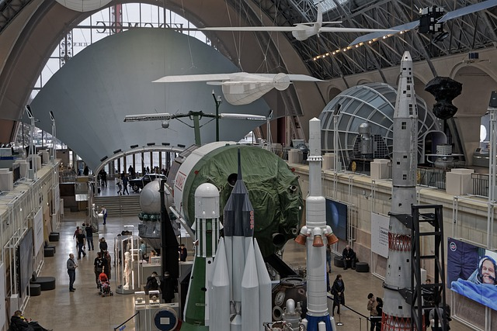
REVIEW
E-museums represent a transformative shift in the museum landscape, offering virtual access to diverse cultural treasures and fostering a more inclusive and engaging cultural experience. This literature review forms the foundation for the development of an E-museum project, highlighting the need for user-centered design and a commitment to preserving and promoting cultural heritage in the digital age.

Slide 5
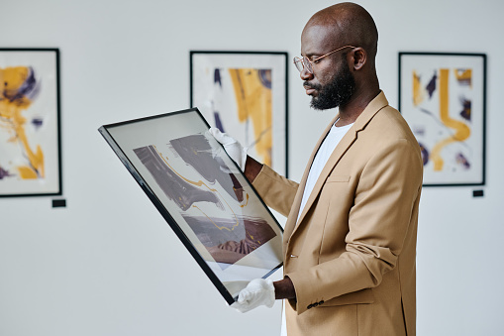
OBJECT
The objective of the E-Museum project is to create an immersive and educational online platform that enables users to explore a diverse range of museums virtually, thereby fostering cultural appreciation, knowledge dissemination, and accessibility.
Virtual Museum Access
Rich Multimedia Content
Accessibility
Community and User Contributions
Continuous Updates

Slide 6
MODULES
USER
ADMIN

Slide 7
USER
Home Page
About us
Booking Form
Review
Login
Logout

Slide 8
ADMIN
User Management
Content Management
Login
Dashboard
Logout

Slide 9
Technologies
HTML CSS
REACT
BOOTSTRAP
MySQL

Slide 10

Editor

Slide 11
CONCLUSION
To conclude ,
Whether you're an art enthusiast, history buff, or a science aficionado, the E-Museum promises an enriching and interactive experience for all. Explore the past, marvel at the present, and envision the future as you embark on a virtual journey through the fascinating world of museums. Welcome to E-Museum, where history, art, and science come to life with just a click.

Slide 12


